Slide 1
Google Maps App
Apps-a-thon 2022

Slide 2
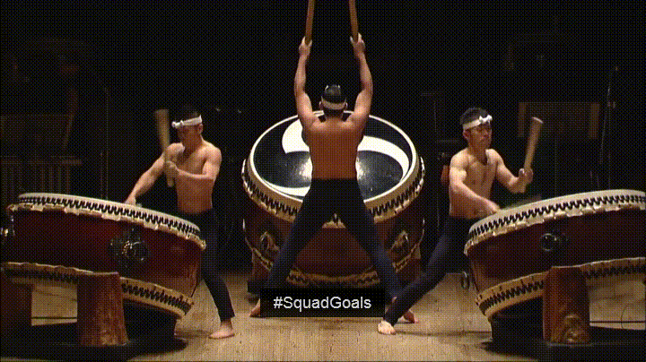
The Team

Slide 3
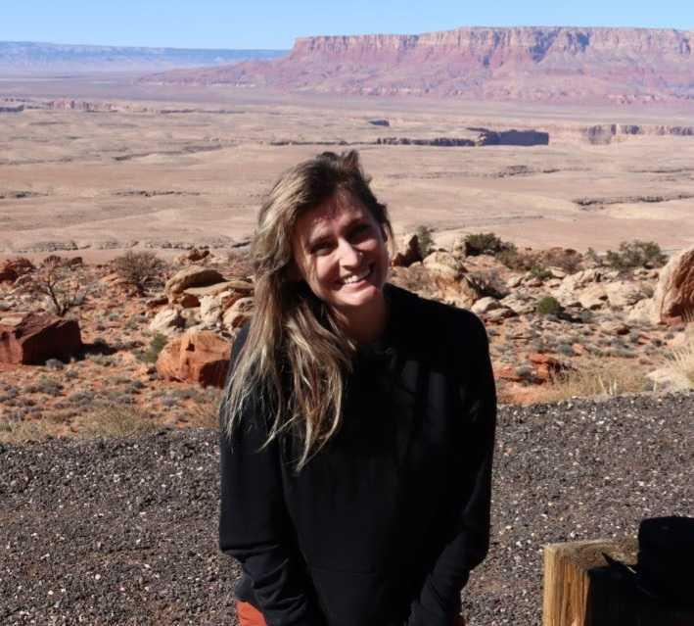
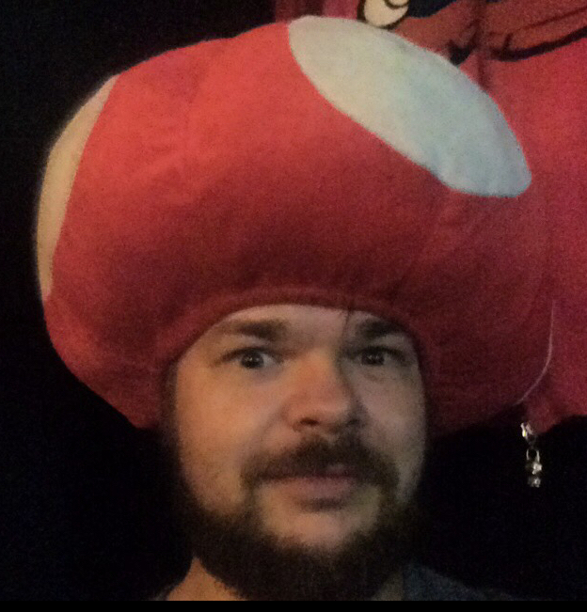
Developer
Sponsor
Steph Simpson
Olly Lord

Slide 4

The App -
Maps

Slide 5
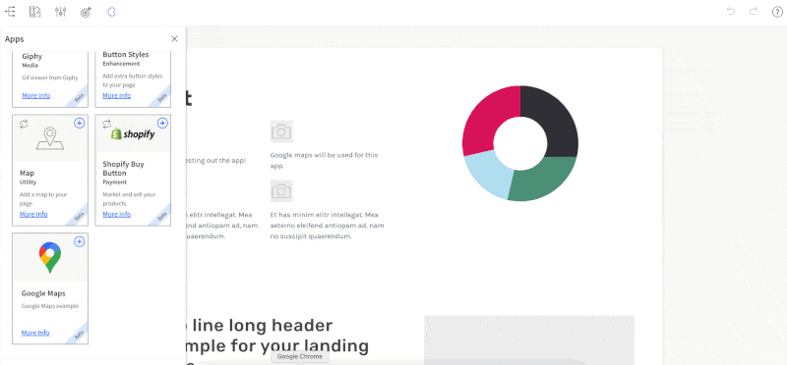
SELECT YOUR TEMPLATE

Slide 6
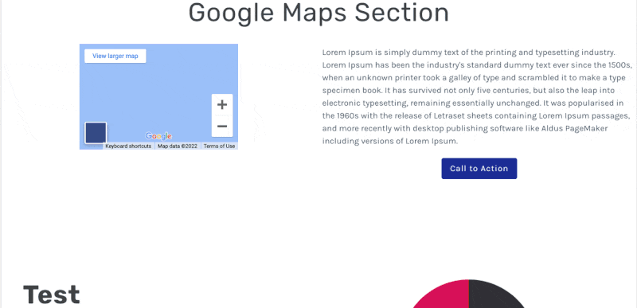
CUSTOMIZE!

Slide 7
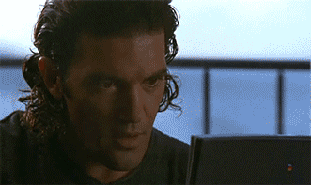
SIT BACK AND RELAX!

